Slide 1
I can describe how words make a rhythm(beat) in a text.

Slide 2
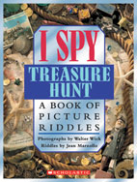
Rhyme
I spy a dime, two dolphins, a tub,
Ten bowling pins, and a little golf club;
Two fishing poles, a leaning mousetrap,
A snowflake, a crab, two bats, and a map.

Slide 3
Alliteration
When words begin with the same letter or sound in a poem or riddle, that is called alliteration.
LAMP LIZARD
SHOVEL ? (NOUN)
? (AJECTIVE) RIBBON

Slide 4
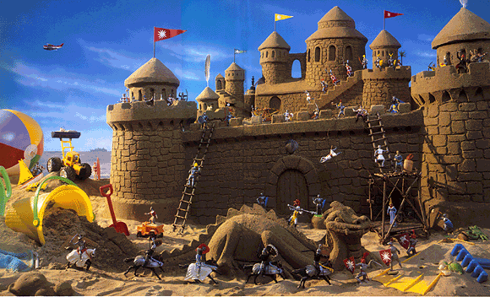
Alliteration
I spy a button, a barrel, a bell.
A little pink pail, and the poor knight who fell;
A towel, a trowel, a taxi, a dog,
A bottle-cap knight, a key, and a frog.

Slide 5
Rhythm
Let’s take a look again at this I Spy riddle.
I spy a button, a barrel, a bell,
A little pink pail, and the poor knight who fell; A towel, a trowel, a taxi, a dog, A bottle-cap knight, a key, and a frog.
Can you hear the pattern of the rhythm? Does anyone want to guess how many beats are in each line?
Rap Video

